Slide 1
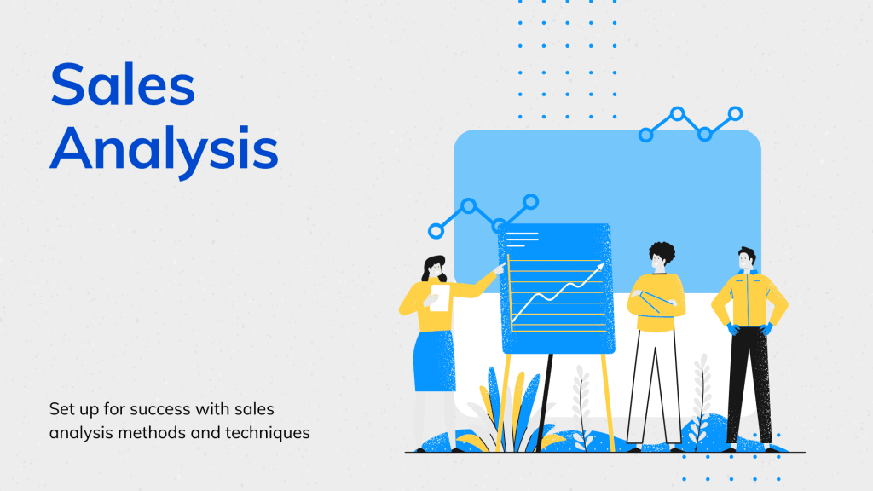

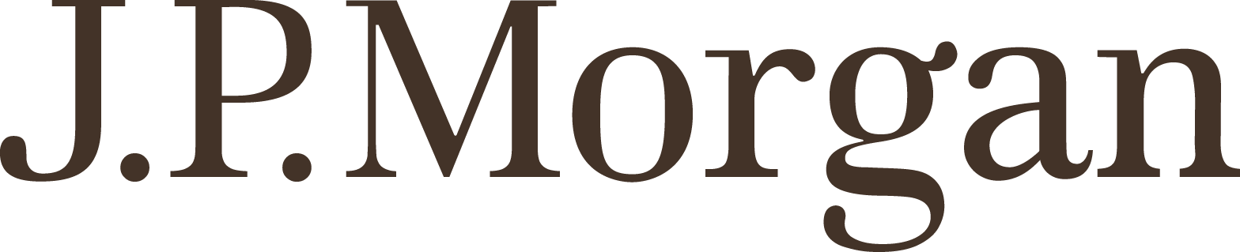
Data-Driven Storytelling Presentation:
Shifting our sales mix toward more online retailer accounts will drive greater sales growth.

Slide 2
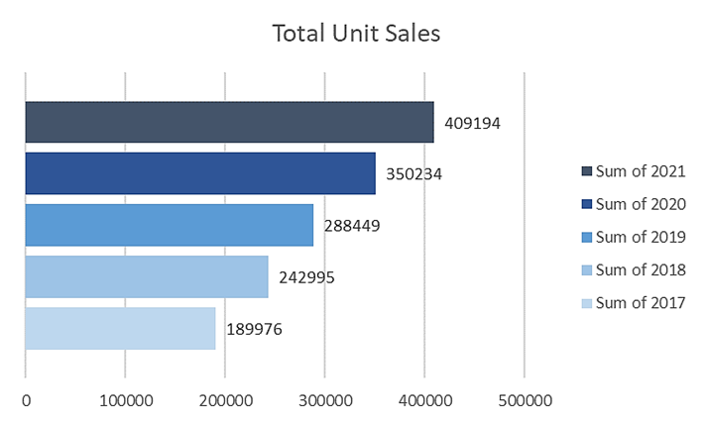
Shifting Our Sales Mix Will Drive Greater Sales Growth
• While our overall sales performance has been good, it could be much better.
• Closing some very poorly performing accounts would free up sales and marketing resources that would be more profitably invested elsewhere.
• Over the last five years, our strongest sales growth has shifted to the online retailer account type.
• Investing the freed-up sales and marketing resources into our online retailer accounts would drive the most sales growth.
Overall, our unit sales growth has been good, with a 5-year CAGR of 21%.

Slide 3
However, we have some very poorly performing accounts that should be closed, which would free up resources to drive sales growth elsewhere.
Shifting our sales resources and our sales mix toward more online retailer accounts would drive greater sales growth.

Slide 4
Summary
• While our overall sales performance has been good, it could be much better.
• Closing some very poorly performing accounts would free up sales and marketing resources that would be more profitably invested elsewhere.
• Over the last five years, our strongest sales growth has shifted to the online retailer account type.
• Investing the freed-up sales and marketing resources into our online retailer accounts would drive the most sales growth.
• We recommend closing these underperforming accounts immediately and launching an effort to identify the highest potential online retailer accounts for increased sales and marketing investment.

